Slide 1
Tick Identification Guide to identifying adult ticks commonly found on people and pets
By: Dr. Kathryn Reif

Slide 2
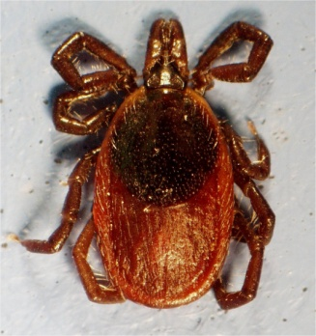
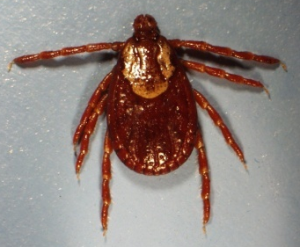
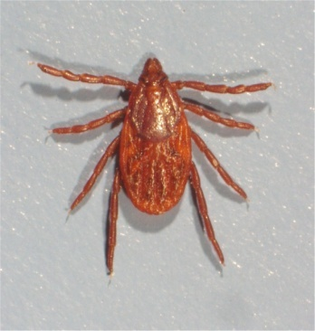
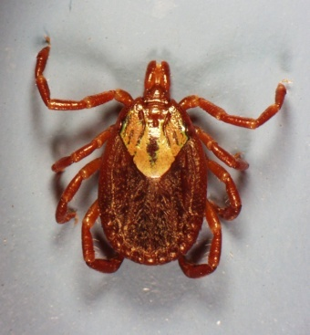
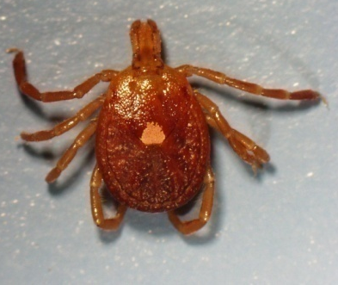
Major Tick Species that Bite Humans and Pets
Common Name | Scientific Name
Black-legged tick | Ixodes scapularis
Lone star tick | Amblyomma americanum
American dog tick | Dermacentor variabilis
Gulf coast tick | Amblyomma maculatum
Rocky Mountain wood tick | Dermacentor andersoni
Western black-legged tick | Ixodes pacificus
Brown dog tick | Rhipicephalus sanguineus

Slide 3
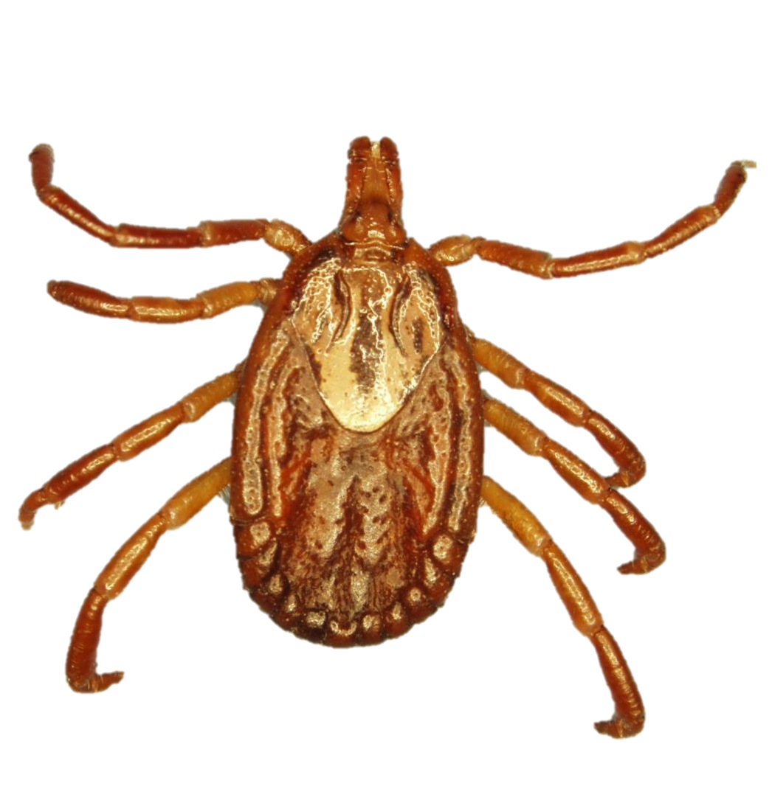
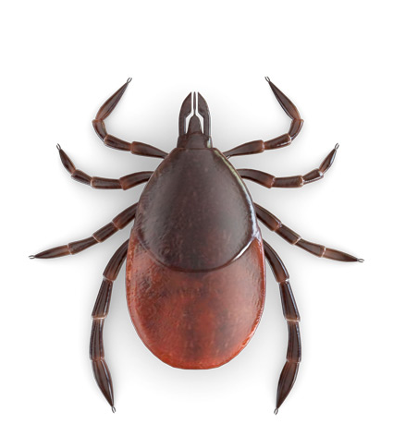
Basic Tick Anatomy
Capitulum
(mouth)
Body
Body
Scutum
Leg
To identify ticks, the four main body parts you need to know are the capitulum (mouth), the scutum, legs, and body.

Slide 4
First make sure you have a TICK
1
5
Adult ticks have 8 LEGS
2
6
3
7
4
8

Slide 5
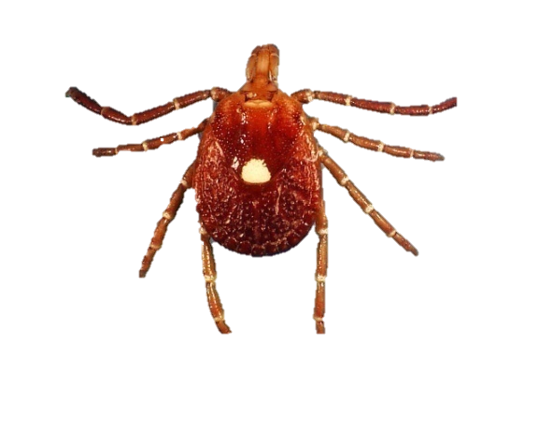
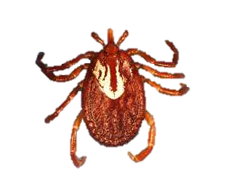
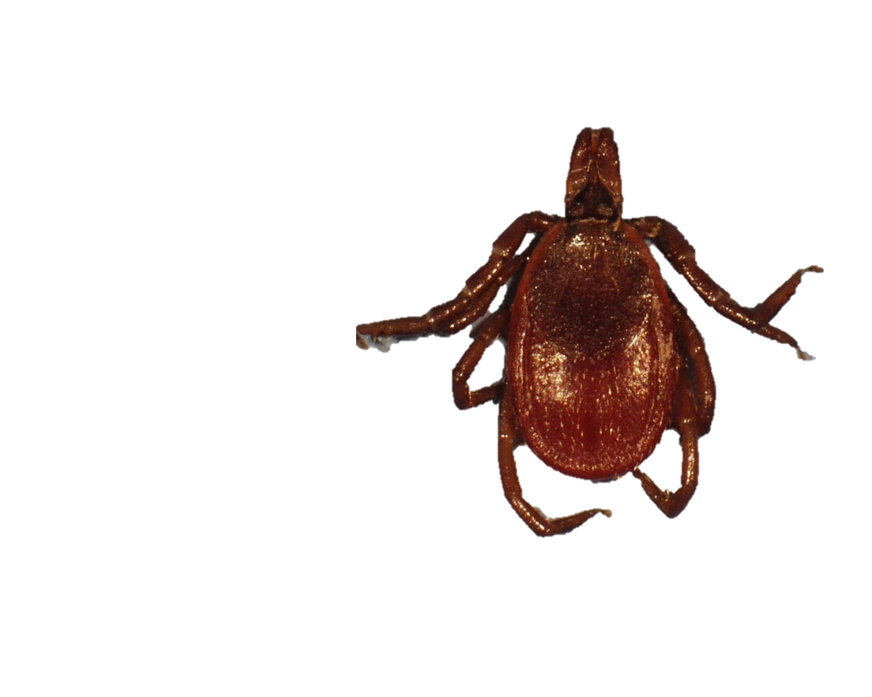
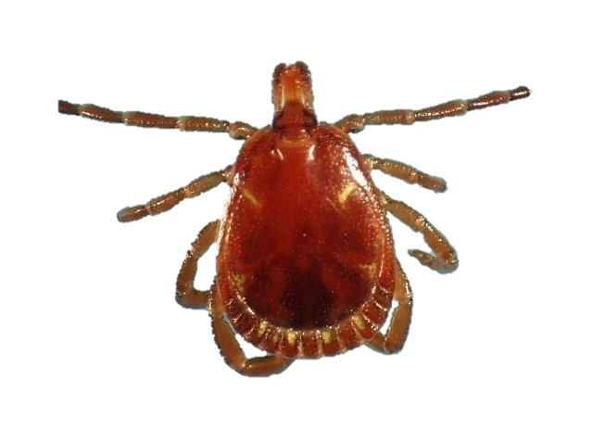
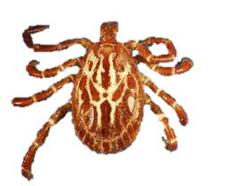
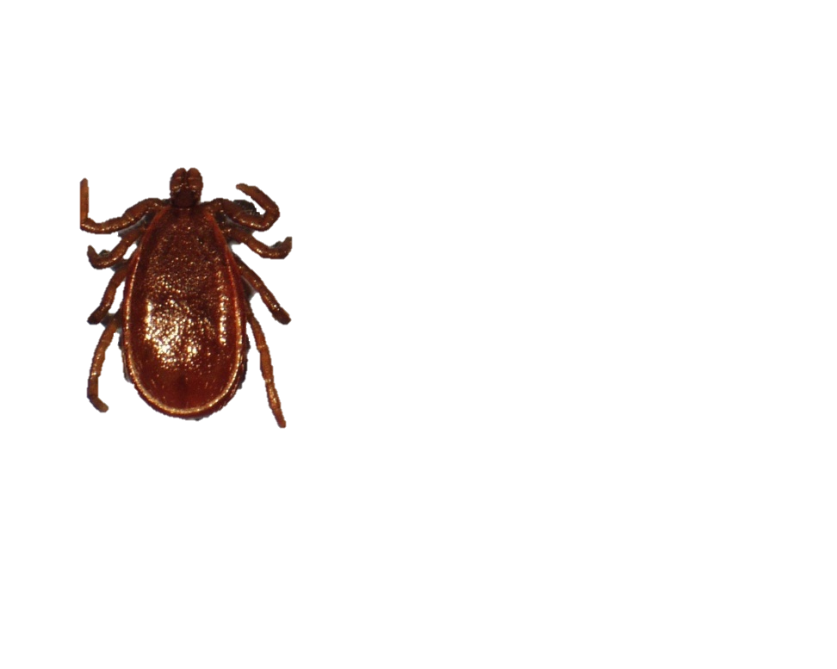
Differentiating MALE versus FEMALE ticks
FEMALE Ticks
MALE Ticks
The scutum is the key!
For MALES: scutum extends the entire length of the body
For FEMALES: scutum extends 1/3 to 1/2 the length of the body (allows her body to expand with eggs)

Slide 6
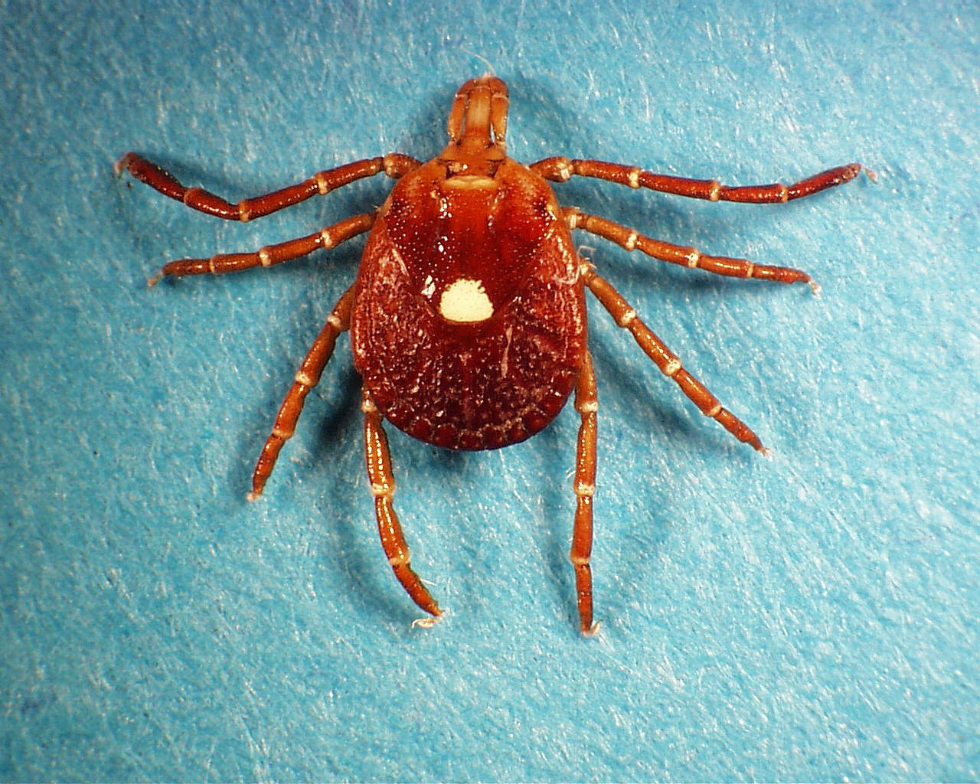
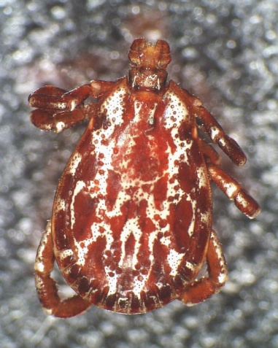
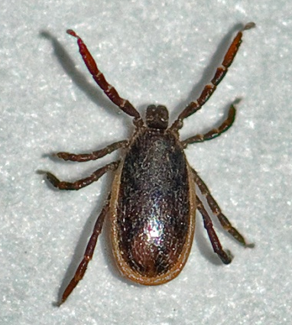
SCUTUM – Ornate or Inornate
Ornate: colored markings present
Inornate: no colored markings present

Slide 7
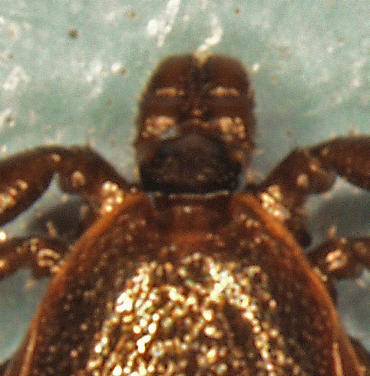
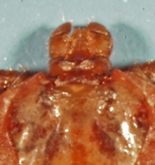
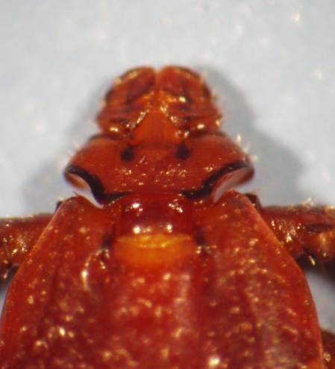
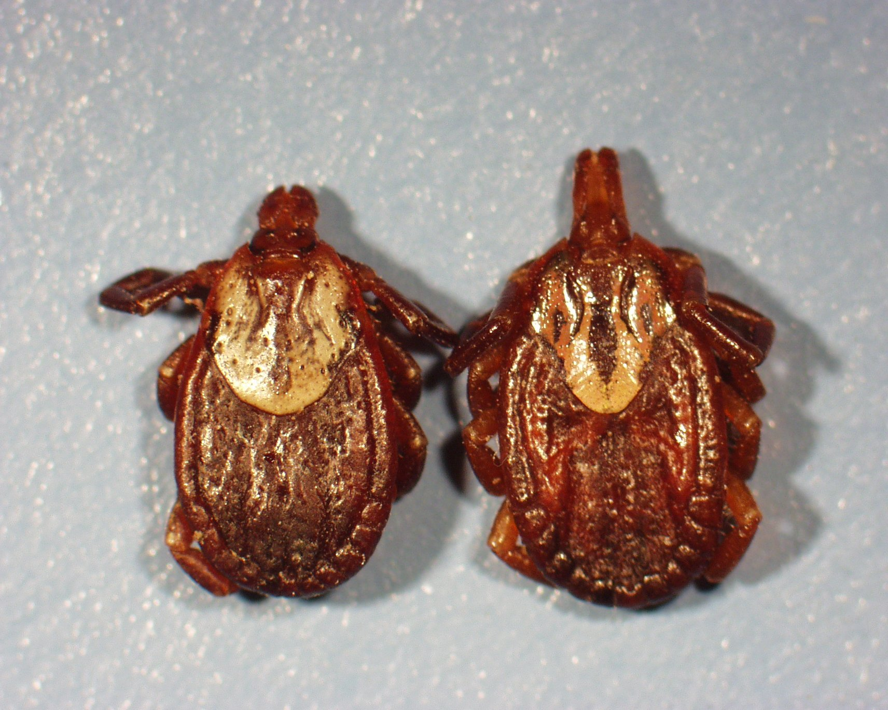
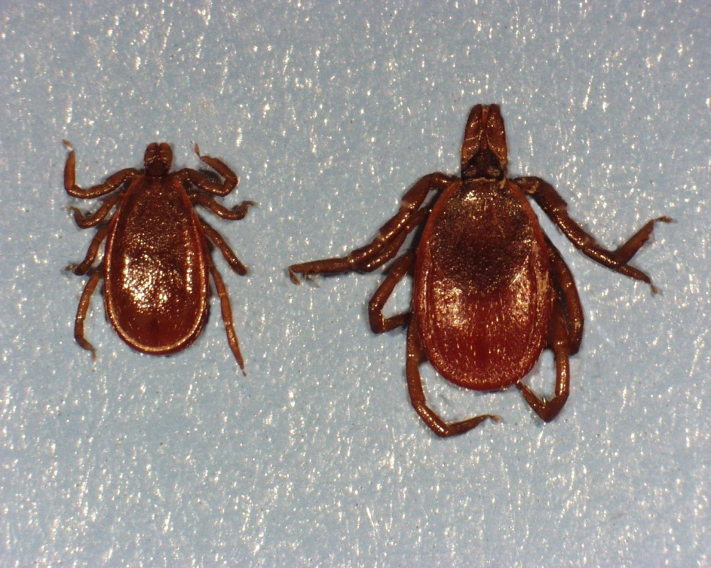
CAPITULUM (Mouth) – Long or Short
Long: mouth longer than it is wide
Short: mouth similar in length and width

Slide 8
Once the tick’s gender is identified, all you need to focus on is the capitulum (mouth) and scutum to identify tick species

Slide 9
MALE ticks
Common Name | Scutum Characteristic | Capitulum Characteristic | Other
Black-legged tick | Inornate | Short | Central and Eastern U.S.
Lone star tick | Inornate | Long
American dog tick | Ornate | Short | Central and Eastern U.S.
Gulf coast tick | Ornate | Long
Rocky Mountain wood tick | Ornate | Short | Western U.S.
Western black-legged tick | Inornate | Short | Western U.S.
Brown dog tick | Inornate | Short | Collar below mouth

Slide 10
FEMALE ticks
Common Name | Scutum Characteristic | Capitulum Characteristic | Other
Black-legged tick | Inornate | Long | Central and Eastern U.S.
Lone star tick | Ornate | Long
American dog tick | Ornate | Short | Central and Eastern U.S.
Gulf coast tick | Ornate | Long
Rocky Mountain wood tick | Ornate | Short | Western U.S.
Western black-legged tick | Inornate | Short | Western U.S.
Brown dog tick | Inornate | Short | Collar below mouth

